Slide 1
Online Examination System
Guided By: Mr. Deo Prakash
Developed By :
Ranjan Jha (2008ECS10)
Amarjeet Kumar (2008ECS13)
Tushar Singhal (2008ECS14)

Slide 2
Introduction
Efficiently evaluate the candidate thoroughly through a fully automated system.
Saves a lot of time and also gives fast results.
Administrator has a privilege to create, modify and delete the test papers.
Web Application provides facility to conduct online examination from anywhere in the world and Remote places.
Being an integrated Online Examination System it will reduce paper work.

Slide 3
SCOPE
Online Examination System is designed for Educatinal Institutes like Schools , Colleges, and Private Institutes to conduct logic tests of their student on a regular basis.
Design To Facilitate Administrator and User
User Friendly Interface
Complete And Secure Information is Provided to User.

Slide 4
TECHNOLOGY USED
Front End
Business Logic
Back End
HTML, CSS, JSP JAVA MySQl
Server Used : Apache Tomcat 6.0
Querying Language : SQL

Slide 5





REQUIREMENTS
Apache Tomcat
Java SDK
IDE for easy devlopment(optional)
Database(MYSQL)

Slide 6
DISADVANTAGES OF CURRENT SYSTEM
The current system is very time consuming.
It is very difficult to analyze the exam manually.
To take exam of more candidates more invigilators are required but no need of invigilator in case of on line exam.
Results are not precise as calculation and evaluations are done
manually.
The chances of paper leakage are more in current system as compared to proposed system.
Result processing takes more time as it is done manually

Slide 7
CHAREACTERSTIC OF THE PROPOSED SYSTEM:
In comparison to the present system the proposed system will be less
time consuming and is more efficient.
Analysis will be very easy in proposed system as it is automated
Result will be very precise and accurate and will be declared in very
short span of time because calculation and evaluations are done by the simulator itself.
The proposed system is very secure as no chances of leakage of
Question paper as it is dependent on the administrator only.
The logs of appeared candidates and their marks are stored and can be backup for future use

Slide 8
Data tables 1. User table
Sr.no | Field name | Data Type | Description
1. | Name | varchar | Store name of the user
2. | Iduser* | Char | Store user name
3. | Password | Varchar | Store password corresponding to username
4. | Gender | Varchar | Gender of user
5. | Address | Varchar | Address of user
6. | Mobileno | Varchar | Mobile no of user
7. | Emailed | Varchar | Email id of user
8 | Type | Varchar | User is “student ” or “admin”
9. | Security | Varchar | User have a security question

Slide 9
2.question
Sr.no. | Field name | Data Type | Description
1. | Questioned | Int* | It is a unique id for each Q.
2. | Question | varchar | Question
3. | A | Varchar | Option a
4. | B | Varchar | Option b
5. | C | Varchar | Option c
6. | D | Varchar | Option d
7. | Ans | Varchar | Answer of the question
8. | Level | Varchar | Level of the question
9. | Subject | Varchar | Subject from the question is

Slide 10
3.schedule:
Sr.no. | Field name | Data Type | Description
1. | Examid* | int | There is unique id for each exam
2. | Date | Date | Date of exam
3. | Time | Time | Time at which exam will start
4. | Tlimit | Time | Time limit of exam
5. | Level | Varchar | Level of exam
6. | Subject | varchar | Subject of exam
7. | Noq | Int | No of question

Slide 11
4.exam_student:
Sr.no. | Field name | Data Type | Description
1. | Examid* | Int | Examid related to a student
2. | Iduser* | Char | Userid of user
3. | Status | varchar | Status of the exam

Slide 12
DESIGN
LOGIN
Student
Administrator
Account
Register
Cancel
Register
Schedule
Add User
Question
Schedule a Exam
Cancel Exam

Slide 13
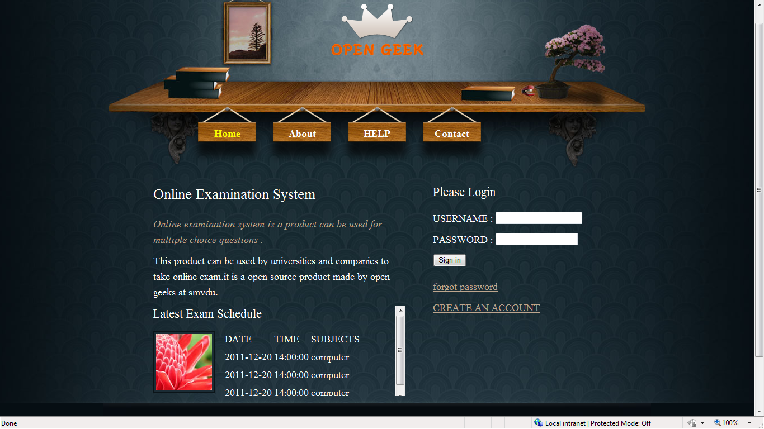
LOGIN

Slide 14
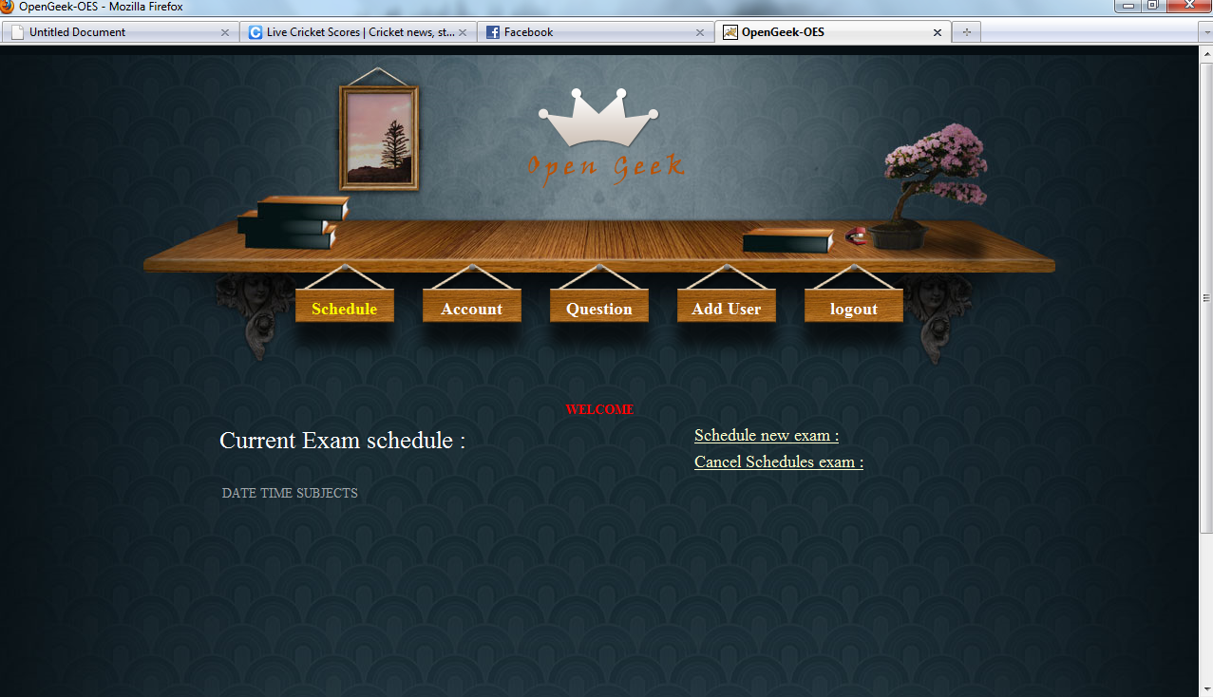
ADMIN_HOME

Slide 15
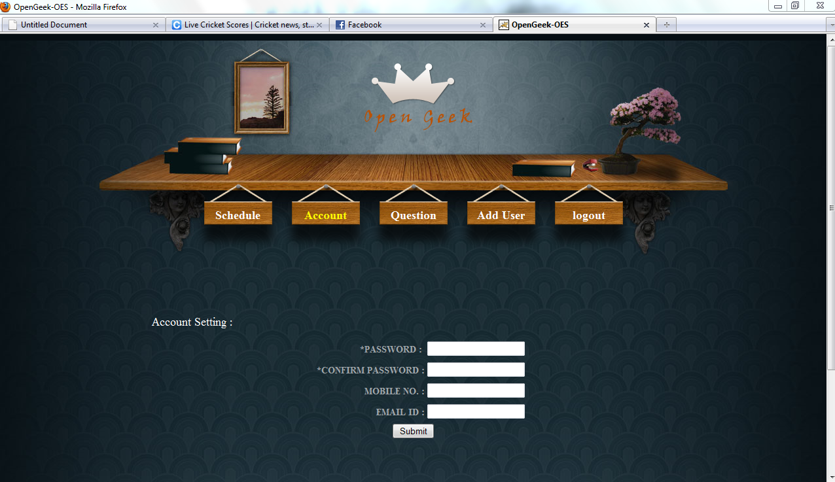
Account_Admin

Slide 16
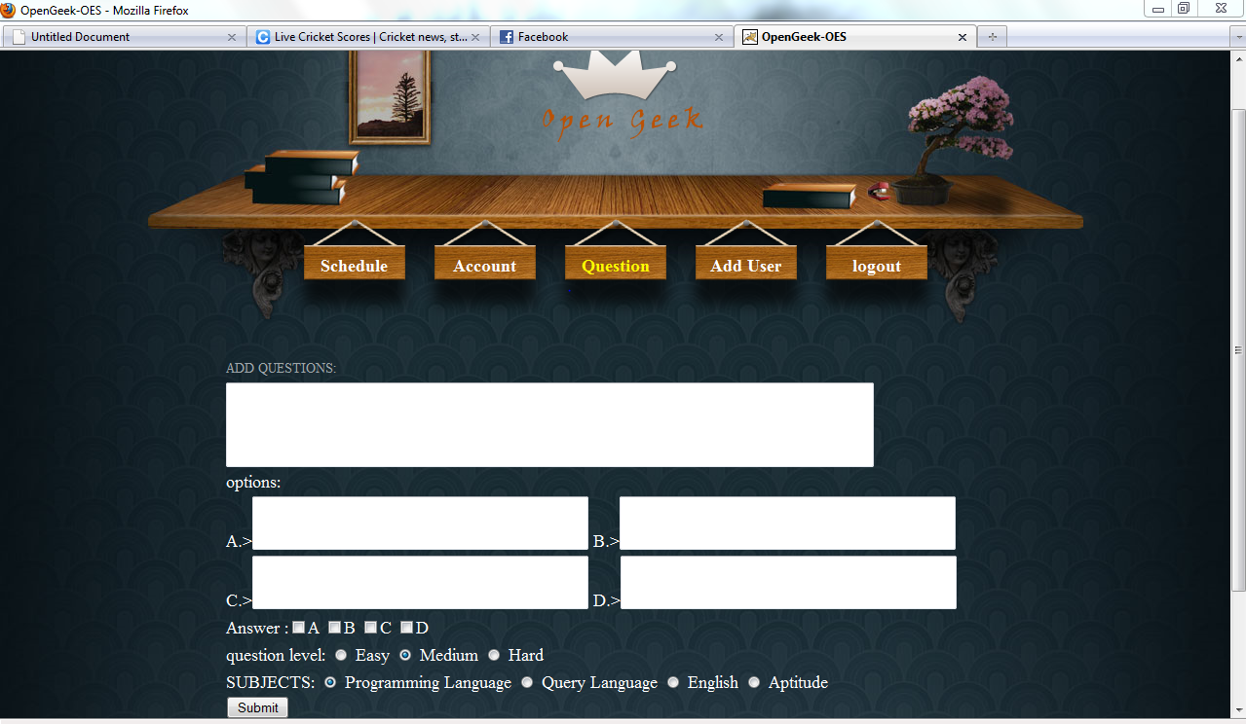
Add_Question

Slide 17
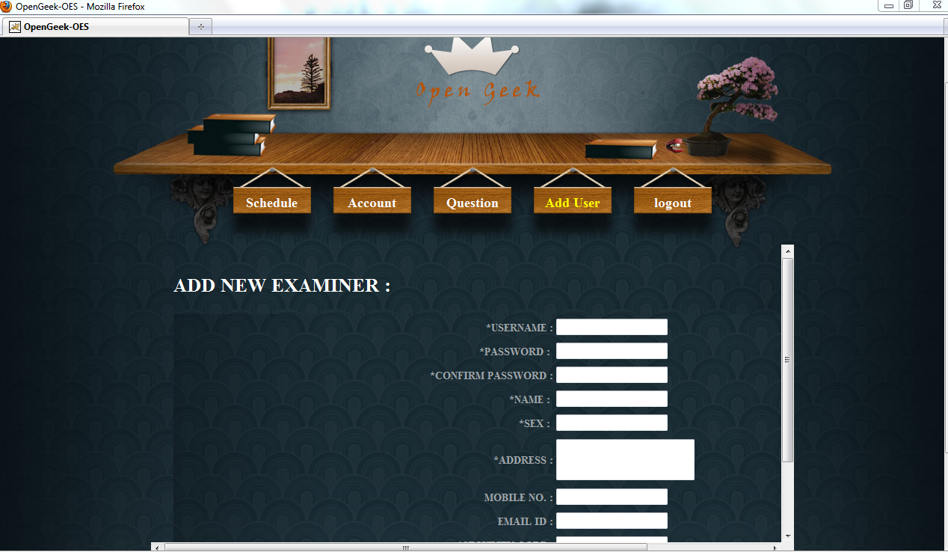
Add_User

Slide 18
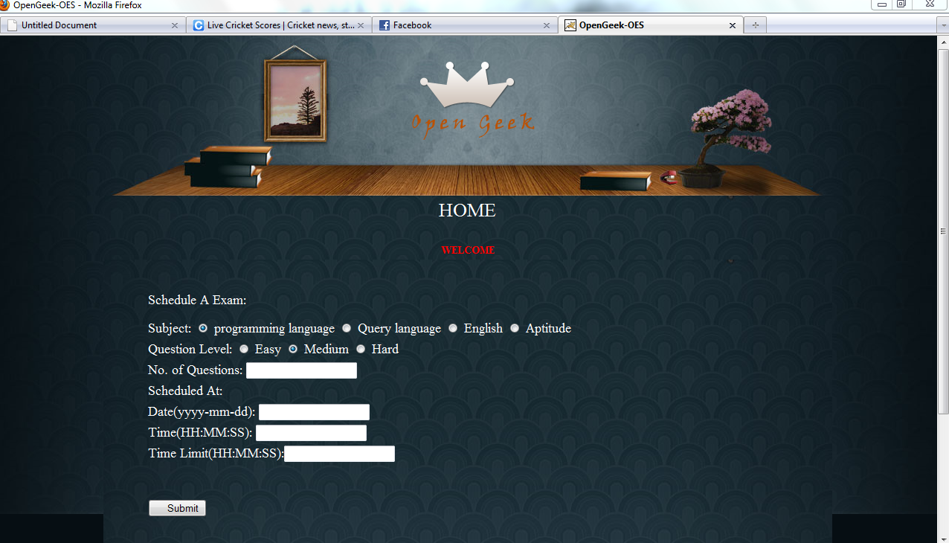
Schedule_New

Slide 19
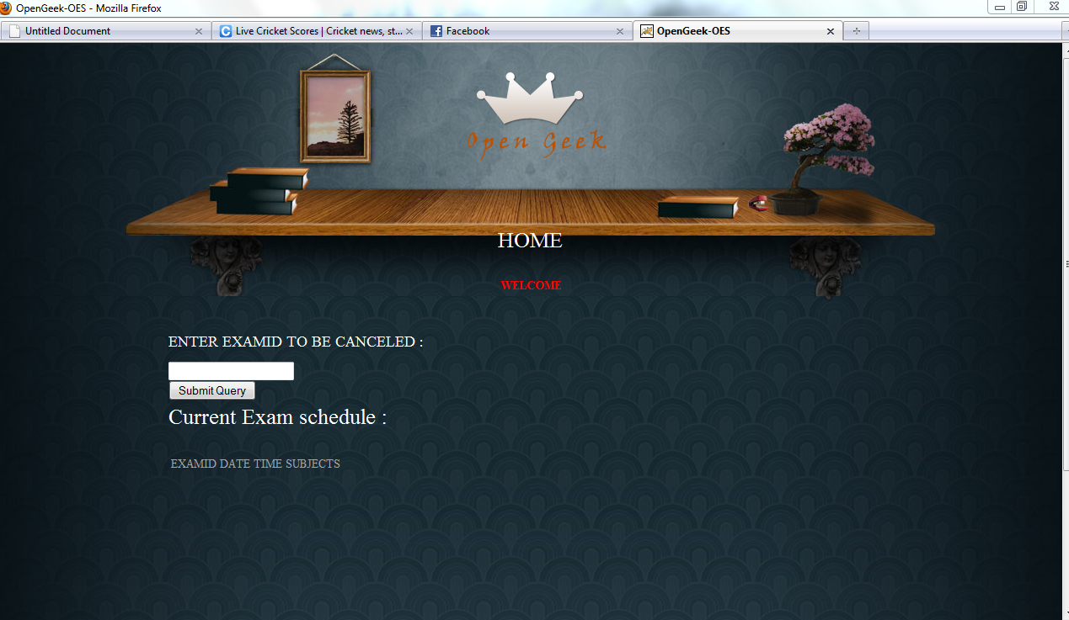
Schedule_Cancel

Slide 20
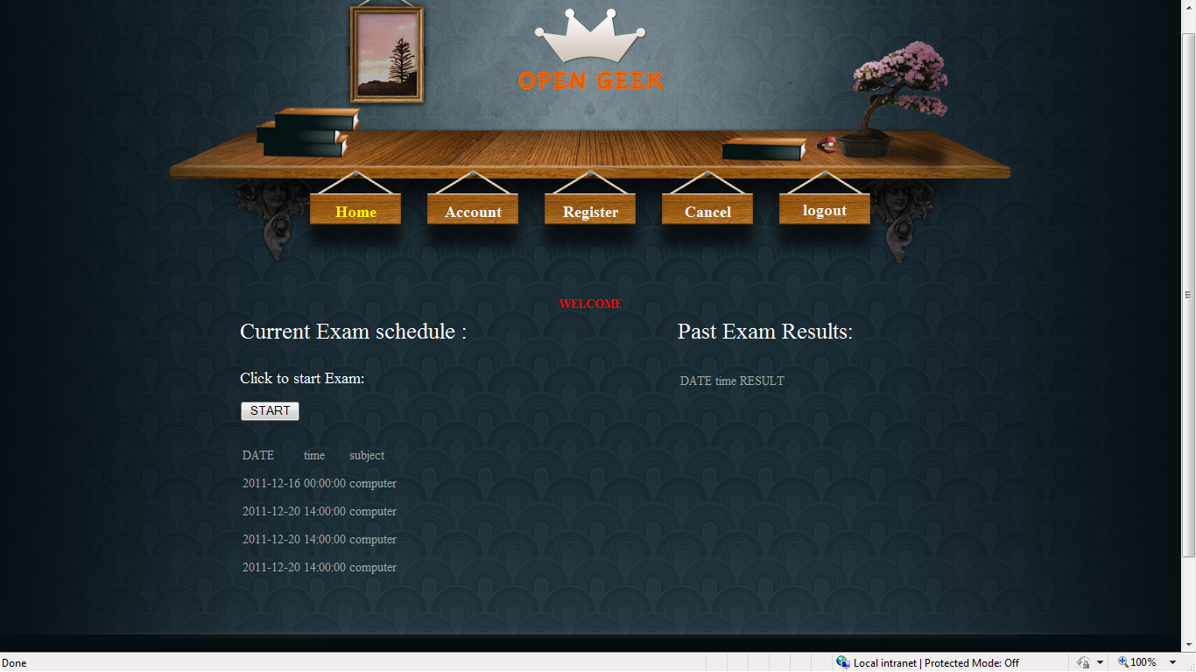
Student_Home

Slide 21
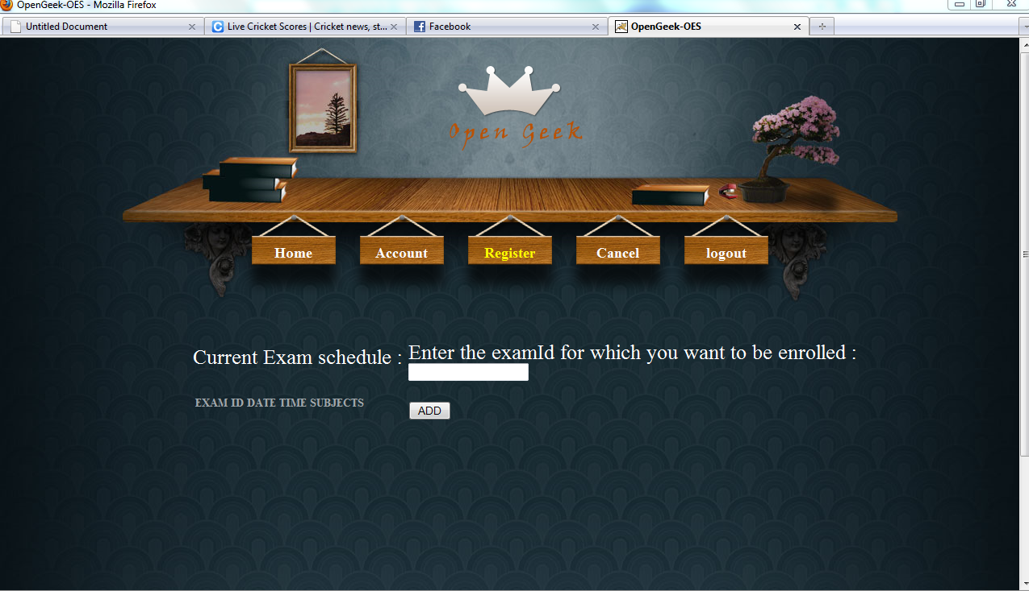
Register_Student

Slide 22
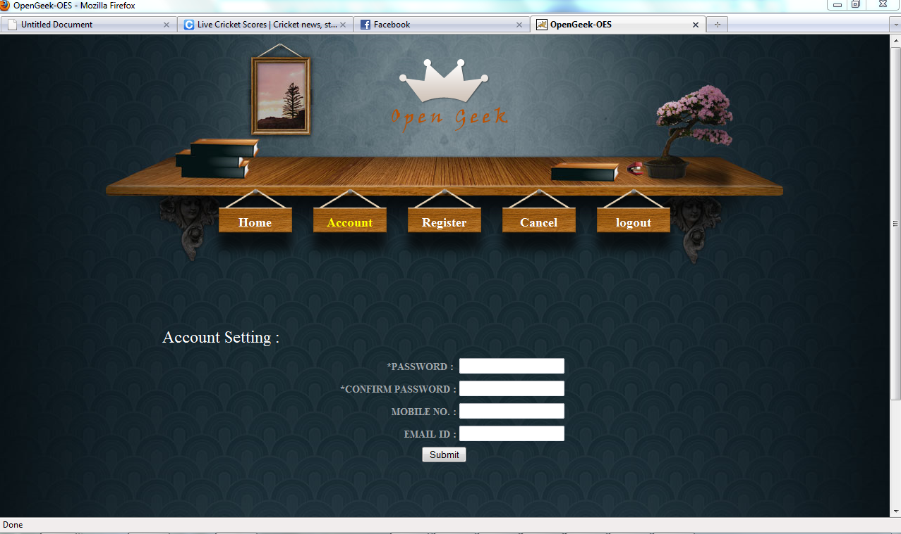
Account_Student

Slide 23
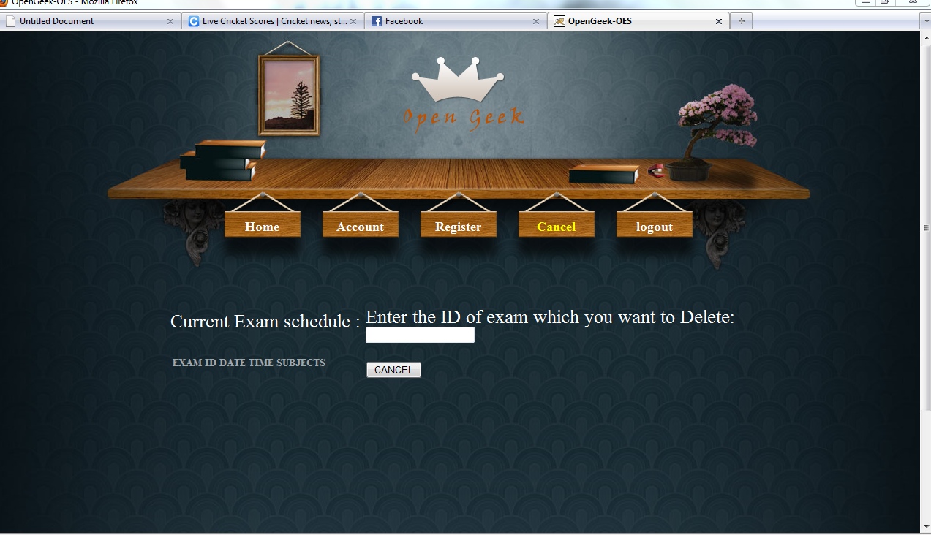
Cancel_Student

Slide 24
Result:
This can be used in educational institutions as well as in corporate world.
Can be used anywhere any time as it is a web based application(user location doesn’t matter)
No restriction that examiner has to be present when the candidate takes the test.

Slide 25
Conclusion:
The On line test System is developed using Java and sql fully meets the objectives of the system for which it has been developed. The system has reached a steady state where all bugs have been eliminated. The system is operated at a high level of efficiency and all the teachers and user associated with the system understands its advantage. The system solves the problem. It was intended to solve as
requirement specification.

Slide 26
Future Enhancements
The System can be enhanced to support other QA types like fill in the blanks, true/false, match the columns etc.
The System can be enhanced by deploying it to the world wide web, so users can use System from distant places.
There is proposition for adding an extra functionality for checking the Subjective answers to with this system.

Slide 27
Thank you !

